Slide 1

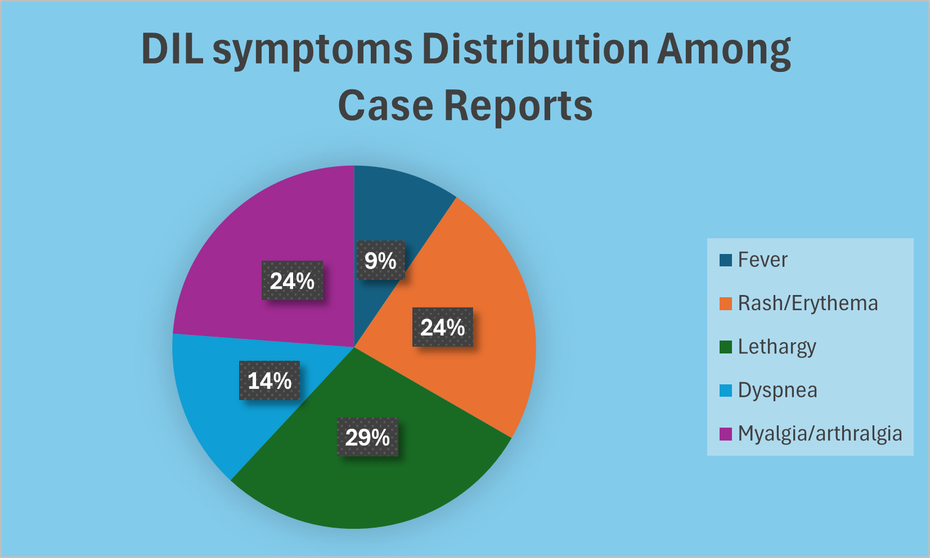
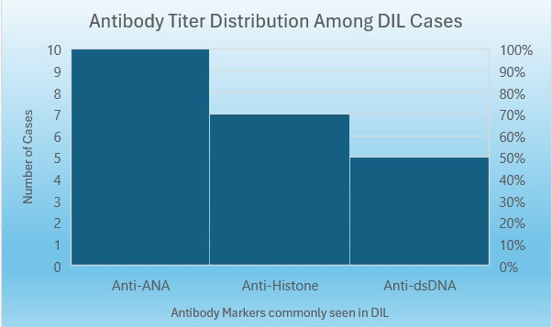
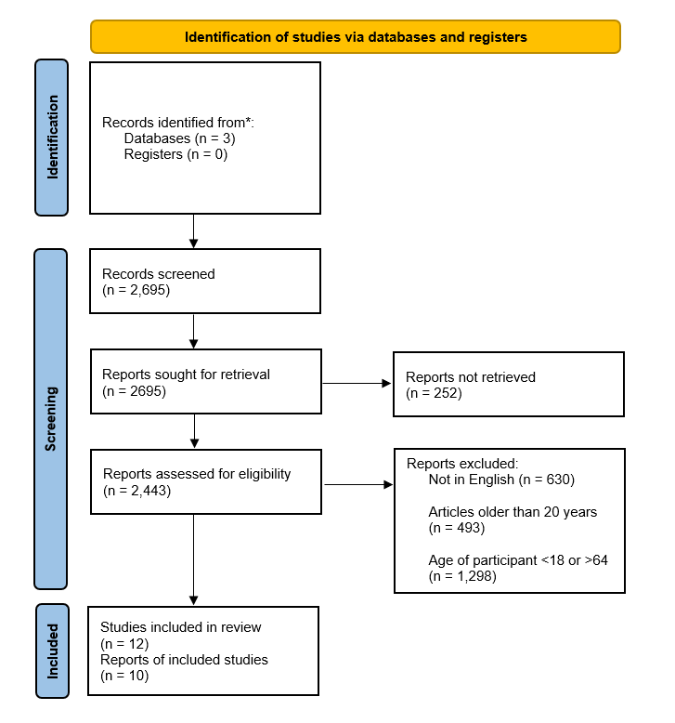

Adalimumab Induced Lupus Erythematosus
A Narrative Review
*Harshan Atwal¹, Jose Fajardo¹, Ryoma Owada¹, Winston Allen¹, Yazeed Hussein¹, Mentor: Rajini Rathore²
¹MD4 Student Saint James School of Medicine, ²Associate Professor Saint James School of Medicine
Introduction
Results
Conclusion
DIL is a condition where certain medications cause an adverse reaction within the body and trigger an autoimmune response. This phenomenon drives the body to induce antibodies that may present as manifestations similar to systemic lupus erythematosus (SLE). Clinical manifestations include rash, arthralgias, serositis, fatigue, muscle pain, and laboratory abnormalities. Common TNF inhibitors used in managing inflammatory diseases include etanercept, infliximab, adalimumab, certolizumab, and golimumab. Diagnostic values include positive antinuclear antibody (ANA), anti double-stranded DNA (dsDNA) antibody, anti-histone antibody, extractable nuclear antibodies (ENA), and low complement levels.
In all the case reports reviewed, patients exposed to Adalimumab all displayed at least one of the symptoms correlating with DIL. Upon withdrawal of the drug, patients displayed cessation of symptoms. Tumor marker C-ANA positive for all cases that were reviewed. Antibodies for dsDNA were present in most cases but not all. It should be noted that patients suffering from DIL may not show any markers or antibodies associated with DIL.
Anti-TNF-α drugs such as Adalimumab have the propensity to cause DIL. Timely recognition of the symptoms of DIL caused by Adalimumab can aid healthcare professionals in early diagnosis and management strategies. Not all patients with DIL will have positive anti-histone, anti-dsDNA, or antinuclear antibodies, highlighting the importance of diagnosis based on clinical presentation Symptom resolution typically occurs within weeks to months following termination of the offending agent with autoantibody titers decreasing and becoming undetectable after months.
Methodology
The outcomes measures included symptoms of DIL caused by adalimumab, diagnostic values that include DIL specific markers and symptom resolution when adalimumab therapy was ceased.
Discussion
Limitations
Drug Induced Lupus (DIL) is reported to be caused by hundreds of medications. This is an autoimmune response to drug exposure that leads to clinical symptoms that closely resemble Systemic Lupus Erythematosus (SLE). These reactions include fatigue, pain, erythema, fever, and rash. Some patients report myalgia and arthritis due to immune complex deposition in joints and muscle. Unlike SLE, DIL does not show anti-Smith antibodies. This can be used to differentiate between DIL and SLE [1]. In all case reports, DIL reactions and symptoms improved following discontinuation of Adalimumab with complete resolution on follow up.
Due to the scarcity of the condition, studies and long-term analyses on the effects of adalimumab, mainly DIL, were limited. The mechanism by which adalimumab induces DIL is not entirely comprehended and may pose obstacles to early diagnosis and intervention.
References

